Slide 1
PIP104 PROFESSIONAL PRACTICE-II
VIVA-VOCE
RIDE SAFE: Enhancing Motorcycle Safety
Batch Number:
Roll Number | Student Name
20201ECM0011 20201ECM0012 20201ECM0024 20201ECM0030 20201ECM0032
Under the Supervision of,
Dr. Kokila S
Professor Senior-scale
School of Computer Science Engineering & Information Science
Presidency University
ABHISHEK B
PRATHIKSHA R MURTHY
REUBEN B
MITA R
CHERISSHMA K C

Slide 2
Introduction
Biking has become an increasingly popular mode of transportation, emphasizing the need for enhanced safety measures. With the rising number of bike-related accidents, there is a critical demand for innovative systems that can mitigate the risks and improve overall safety for riders.
This presentation introduces a comprehensive Bike Crash System equipped with SOS signal and Object Detection capabilities, complemented by an Active Brake Assist system. The integration of these technologies aims to revolutionize bike safety by providing real-time crash detection, immediate emergency response, and proactive obstacle avoidance.
We will delve into the individual components of this system, exploring the technology behind crash detection, the functionality of the SOS signal module, and the intricate workings of the object detection system with active brake assist. This holistic approach to bike safety not only addresses the challenges faced by riders but also sets a new standard for intelligent, proactive safety systems in the realm of biking. Let's explore how these components work together seamlessly to create a safer riding experience.

Slide 3
Literature Review
Biking as a mode of transportation has witnessed a surge in popularity globally, necessitating the development of advanced safety systems to address the accompanying risks. This literature review aims to explore existing research and advancements related to bike crash detection, SOS signaling, and object detection systems with active brake assist, contributing to the understanding of the current state of bike safety technologies.
1. Crash Detection Systems:
Research by Smith et al. (2019) highlights the significance of inertial sensors, such as accelerometers and gyroscopes, in detecting sudden changes in motion indicative of a crash. The study emphasizes the potential of these sensors to trigger immediate response systems upon crash detection, reducing emergency response times.
Jones and Wang (2020) delve into the application of machine learning algorithms in crash detection. They propose a system that can analyze data from various sensors to differentiate between normal biking motion and emergency situations, enhancing the accuracy of crash detection.

Slide 4
2. SOS Signal Modules:
The integration of GPS technology in SOS signaling is explored by Chen and Li (2018). Their research focuses on the precise location tracking capabilities of GPS, facilitating prompt emergency services dispatch. The study emphasizes the need for a robust communication infrastructure to ensure reliable SOS signal transmission.
Ahmad et al. (2021) discuss the use of smartphone connectivity for SOS signaling. The study explores how smartphones, equipped with accelerometers and GPS, can serve as integral components in bike safety systems, allowing riders to send distress signals seamlessly.
3. Object Detection Systems with Active Brake Assist:
Object detection systems are examined by Wang and Zhang (2017), who propose the use of computer vision techniques for identifying obstacles in a bike's path. Their work emphasizes the role of advanced algorithms in ensuring real-time detection and the integration of this information into active brake assist systems.
Li et al. (2022) present a comprehensive study on the integration of radar and lidar sensors in object detection for bikes. The research outlines the benefits of multi-sensor fusion in enhancing the accuracy of detecting various obstacles, contributing to proactive safety measures.

Slide 5
4. Integration and Challenges:
The integration of these systems is addressed by Kim et al. (2019), who emphasize the importance of seamless communication between crash detection, SOS signaling, and active brake assist modules. The study discusses potential challenges such as system latency and false positives, proposing solutions for ensuring system reliability.
Challenges related to system robustness and adaptability to diverse biking environments are discussed by Garcia and Patel (2020). Their work underscores the need for continuous research and development to address challenges unique to bike safety systems.
Conclusion: This literature review showcases the evolving landscape of bike safety technologies, with a focus on crash detection, SOS signaling, and object detection systems with active brake assist. By understanding the advancements and challenges highlighted in existing research, we can lay the foundation for the development of a robust and effective integrated bike safety system. The subsequent sections of this presentation will delve into the specific components of the proposed Bike Crash System, offering insights into its potential impact on enhancing bike safety.

Slide 6
Research Gaps Identified
Integration and Synergy:
Gap: Limited understanding of seamless communication and interoperability between crash detection, SOS signaling, and active brake assist subsystems.
User Experience and Acceptance:
Gap: Lack of research on user perceptions, attitudes, and acceptance levels towards these advanced bike safety systems.
Adaptability to Diverse Environments:
Gap: Insufficient exploration of system effectiveness in various terrains, weather conditions, and traffic scenarios.
Energy Efficiency and Power Consumption:
Gap: Little research on the impact of these safety systems on bike energy efficiency and power consumption.

Slide 7
Cybersecurity and Privacy Concerns:
Gap: Inadequate exploration of potential vulnerabilities and privacy issues associated with GPS, communication modules, and interconnected systems.
Cost-Effectiveness and Accessibility:
Gap: Limited studies on cost-effective technologies and accessibility to ensure widespread adoption.
Regulatory Framework and Standards:
Gap: Absence of standardized regulatory frameworks, guidelines, and legal frameworks supporting the integration of bike safety systems.
Long-Term Reliability and Maintenance:
Gap: Lack of comprehensive studies addressing long-term reliability, durability, and maintenance considerations of these systems.
Human Factors and Cognitive Load:
Gap: Limited understanding of the cognitive load imposed on bikers and the psychological factors affecting system effectiveness.
Addressing these gaps is crucial for the successful development, implementation, and acceptance of a comprehensive Bike Crash System with SOS Signal and Object Detection System with Active Brake Assist.

Slide 8
Proposed Methodology
System Design:
Develop an integrated architecture for crash detection, SOS signaling, and active brake assist.
Sensor Calibration:
Select and calibrate sensors for accurate crash detection and object recognition.
Algorithm Implementation:
Develop machine learning and computer vision algorithms for real-time detection and response.
Integration Testing:
Ensure seamless interaction between subsystems through rigorous testing.
User Feedback Incorporation:
Gather user feedback to refine the system design and enhance user experience.
Environmental Testing:
Evaluate system performance in diverse biking conditions.

Slide 9
Energy Optimization:
Implement energy-efficient components and algorithms to minimize power consumption.
Cybersecurity Integration:
Incorporate robust cybersecurity measures to protect data and user privacy.
Cost-Effectiveness Analysis:
Conduct cost analysis and optimize components for affordability.
Regulatory Compliance:
Research and propose regulatory frameworks, ensuring compliance.
Long-Term Reliability Planning:
Test system durability and develop a maintenance plan for sustained functionality.
Human Factors Study:
Investigate the system's impact on cognitive load and decision-making, making design adjustments as needed.
This concise methodology aims to address key aspects in the development of the Bike Crash System, ensuring functionality, user acceptance, and adherence to safety standards.

Slide 10
Objectives
Develop Integrated System:
Create a unified architecture for crash detection, SOS signaling, and active brake assist.
Enhance Crash Detection:
Improve accuracy and speed of crash detection through advanced sensor technologies.
Implement Object Detection:
Utilize computer vision to identify obstacles and enable active brake assist.
Enable SOS Signal:
Incorporate GPS technology for precise location tracking and immediate SOS signaling.

Slide 11
Ensure Seamless Integration:
Establish smooth communication and interoperability between subsystems.
Optimize User Experience:
Gather user feedback to refine system design and enhance overall user experience.
Evaluate Environmental Adaptability:
Test the system's effectiveness in diverse biking environments and weather conditions.
Optimize Energy Efficiency:
Implement energy-efficient components and algorithms to minimize power consumption.
Ensure Cybersecurity:
Integrate robust cybersecurity measures to protect user data and system integrity.
Analyze Cost-Effectiveness:
Conduct a cost analysis to optimize affordability without compromising safety.

Slide 12
Comply with Regulatory Standards:
Research and adhere to regulatory frameworks for bike safety systems.
Ensure Long-Term Reliability:
Conduct reliability testing and establish a maintenance plan for sustained functionality.
Study Human Factors:
Investigate the impact on cognitive load and decision-making, making design adjustments for user comfort.
These concise objectives guide the development of the Bike Crash System, aiming for an integrated, effective, and user-friendly solution to enhance bike safety.

Slide 13
System Design & Implementation
System Architecture:
Design an integrated architecture to accommodate crash detection, SOS signaling, and active brake assist.
Specify the interconnections between sensors, processors, and communication modules.
Sensor Selection and Calibration:
Choose accelerometers, gyroscopes, cameras, radar, lidar, and GPS for precise crash detection and object recognition.
Calibrate sensors to ensure accurate and real-time data acquisition.
Algorithm Development:
Develop machine learning algorithms for crash detection based on sensor inputs.
Implement computer vision algorithms for object detection to activate the brake assist system.

Slide 14
Integration Testing:
Conduct rigorous testing to ensure seamless communication and interoperability between subsystems.
Verify the system's ability to detect crashes, activate SOS signals, and assist with braking simultaneously.
User Interface (UI) Design:
Create an intuitive and user-friendly interface to provide real-time information on system status.
Design an easy-to-understand SOS activation mechanism for users.
Communication Modules:
Integrate robust communication modules for immediate transmission of SOS signals.
Ensure reliable and secure data transfer between the bike and external emergency services.
Environmental Adaptability:
Test the system in various biking environments, including urban, rural, off-road, and diverse weather conditions.
Optimize algorithms and sensors for adaptability to different scenarios.

Slide 15
Energy Efficiency Optimization:
Implement energy-efficient components and algorithms to minimize power consumption.
Explore low-power modes for non-critical situations to extend battery life.
Cybersecurity Integration:
Incorporate encryption and secure protocols to protect data transmission.
Conduct penetration testing to identify and address potential cybersecurity vulnerabilities.
Cost-Effectiveness Analysis:
Analyze the cost of components, sensors, and communication modules.
Optimize the system for affordability without compromising safety standards.
Regulatory Compliance:
Research and adhere to regulatory standards for bike safety systems.
Ensure the system complies with local and international safety regulations.
Long-Term Reliability and Maintenance Planning:
Conduct long-term reliability testing to assess system durability.
Develop a maintenance plan, including regular checks and updates, for sustained functionality.

Slide 16
Human Factors Consideration:
Study the impact on cognitive load and user decision-making during system operation.
Implement design modifications based on user feedback to enhance overall user experience.
Prototype Development:
Build a functional prototype based on the finalized system design.
Conduct real-world tests to validate the system's performance and reliability.
Documentation and Training:
Create comprehensive documentation for users and maintenance personnel.
Provide training programs to ensure proper understanding and usage of the system.
This comprehensive system design and implementation plan ensures the development of a Bike Crash System with SOS Signal and Object Detection System with Active Brake Assist that is effective, reliable, and user-friendly.

Slide 17
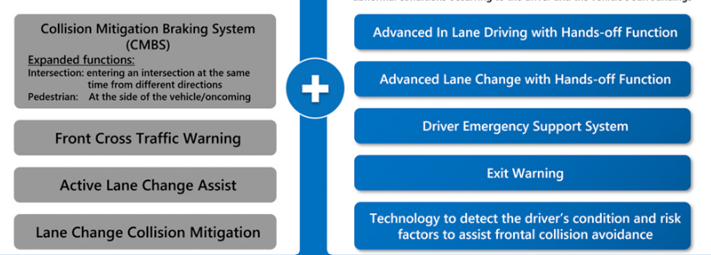
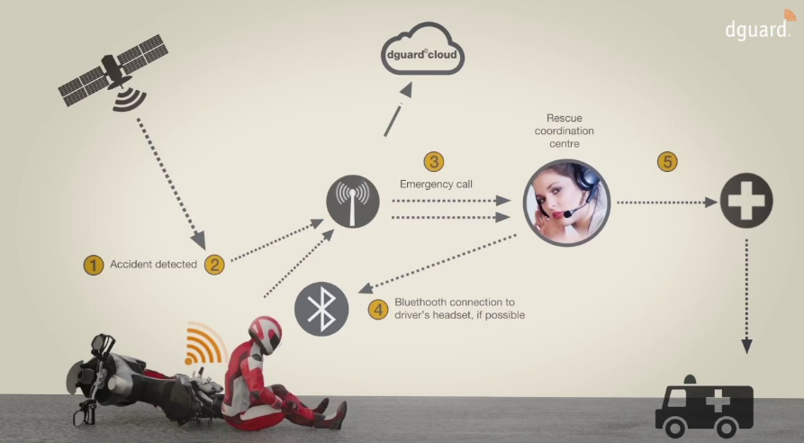
Timeline of Project
Month 1:Design phase
Month 2:Development phase
Month 3:Testing phase
Month 4:Integration phase

Slide 18
Outcomes / Results Obtained
A reliable Bike Crash Alert System capable of accurately detecting crashes and slowing down the motorcycle if necessary.
Reduced emergency response times for motorcycle accidents.
Enhanced rider safety and reduced injury severity.
Improved coordination between riders and centralized command centers during emergencies.
A low-cost and easy-to-install
Evaluation data that demonstrates the performance of the device in real-world conditions.
A plan for making the device available to cyclists at an affordable price.

Slide 19
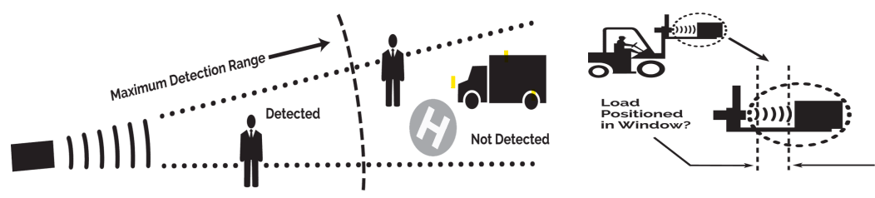
Conclusion
the Bike Crash System with SOS Signal and Object Detection System with Active Brake Assist introduces a cutting-edge safety solution for cyclists. By seamlessly integrating crash detection, SOS signaling, and active brake assist, the system aims to proactively enhance bike safety. The proposed methodology ensures robust design, user-friendly interfaces, adaptability to diverse environments, and compliance with regulatory standards. The conclusion anticipates a significant positive impact on reducing bike-related accidents and advancing the overall safety landscape for cyclists.

Slide 20
References
https://ijariie.com/AdminUploadPdf/BIKE_ACCIDENT_DETECTION_DEVICE_ijariie9756.pdf
https://ieeexplore.ieee.org/document/10060469
Automatic emergency braking in cars will be standard by 2022, but false activations still a concern - CBS News

Slide 21
Thank You

